Slide 1
Basic Parsing with Context-Free Grammars
Slides adapted from Dan Jurafsky and Julia Hirschberg

Slide 2
Homework Announcements and Questions?
Last year’s performance
Source classification: 89.7% average accuracy, SD of 5
Topic classification: 37.1% average accuracy, SD of 13
Topic classification is actually 12-way classification; no document is tagged with BT_8 (finance)

Slide 3
What’s right/wrong with….
Top-Down parsers – they never explore illegal parses (e.g. which can’t form an S) -- but waste time on trees that can never match the input. May reparse the same constituent repeatedly.
Bottom-Up parsers – they never explore trees inconsistent with input -- but waste time exploring illegal parses (with no S root)
For both: find a control strategy -- how explore search space efficiently?
Pursuing all parses in parallel or backtrack or …?
Which rule to apply next?
Which node to expand next?

Slide 4
Some Solutions
Dynamic Programming Approaches – Use a chart to represent partial results
CKY Parsing Algorithm
Bottom-up
Grammar must be in Normal Form
The parse tree might not be consistent with linguistic theory
Early Parsing Algorithm
Top-down
Expectations about constituents are confirmed by input
A POS tag for a word that is not predicted is never added
Chart Parser

Slide 5
Earley
Intuition
Extend all rules top-down, creating predictions
Read a word
When word matches prediction, extend remainder of rule
Add new predictions
Go to 2
Look at N+1 to see if you have a winner

Slide 6
Earley Parsing
Allows arbitrary CFGs
Fills a table in a single sweep over the input words
Table is length N+1; N is number of words
Table entries represent
Completed constituents and their locations
In-progress constituents
Predicted constituents

Slide 7
States
The table-entries are called states and are represented with dotted-rules.
S -> · VP A VP is predicted
NP -> Det · Nominal An NP is in progress
VP -> V NP · A VP has been found

Slide 8
States/Locations
It would be nice to know where these things are in the input so…
S -> · VP [0,0] A VP is predicted at the start of the sentence
NP -> Det · Nominal [1,2] An NP is in progress; the Det goes from 1 to 2
VP -> V NP · [0,3] A VP has been found starting at 0 and ending at 3

Slide 9
Graphically

Slide 10
Earley
As with most dynamic programming approaches, the answer is found by looking in the table in the right place.
In this case, there should be an S state in the final column that spans from 0 to n+1 and is complete.
If that’s the case you’re done.
S –> α · [0,n+1]

Slide 11
Earley Algorithm
March through chart left-to-right.
At each step, apply 1 of 3 operators
Predictor
Create new states representing top-down expectations
Scanner
Match word predictions (rule with word after dot) to words
Completer
When a state is complete, see what rules were looking for that completed constituent

Slide 12
Predictor
Given a state
With a non-terminal to right of dot
That is not a part-of-speech category
Create a new state for each expansion of the non-terminal
Place these new states into same chart entry as generated state, beginning and ending where generating state ends.
So predictor looking at
S -> . VP [0,0]
results in
VP -> . Verb [0,0]
VP -> . Verb NP [0,0]

Slide 13
Scanner
Given a state
With a non-terminal to right of dot
That is a part-of-speech category
If the next word in the input matches this part-of-speech
Create a new state with dot moved over the non-terminal
So scanner looking at
VP -> . Verb NP [0,0]
If the next word, “book”, can be a verb, add new state:
VP -> Verb . NP [0,1]
Add this state to chart entry following current one
Note: Earley algorithm uses top-down input to disambiguate POS! Only POS predicted by some state can get added to chart!

Slide 14
Completer
Applied to a state when its dot has reached right end of rule.
Parser has discovered a category over some span of input.
Find and advance all previous states that were looking for this category
copy state, move dot, insert in current chart entry
Given:
NP -> Det Nominal . [1,3]
VP -> Verb. NP [0,1]
Add
VP -> Verb NP . [0,3]

Slide 15
Earley: how do we know we are done?
How do we know when we are done?.
Find an S state in the final column that spans from 0 to n+1 and is complete.
If that’s the case you’re done.
S –> α · [0,n+1]

Slide 16
Earley
More specifically…
Predict all the states you can upfront
Read a word
Extend states based on matches
Add new predictions
Go to 2
Look at N+1 to see if you have a winner

Slide 17
Example
Book that flight
We should find… an S from 0 to 3 that is a completed state…

Slide 18
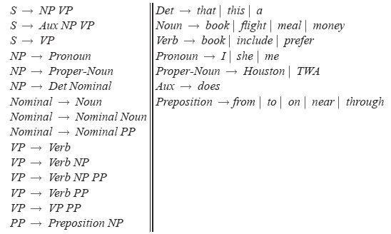
Sample Grammar

Slide 19
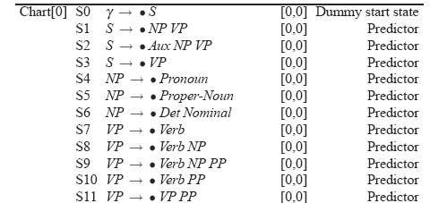
Example

Slide 20
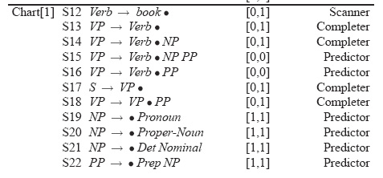
Example

Slide 21
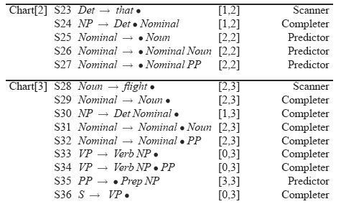
Example

Slide 22
Details
What kind of algorithms did we just describe
Not parsers – recognizers
The presence of an S state with the right attributes in the right place indicates a successful recognition.
But no parse tree… no parser
That’s how we solve (not) an exponential problem in polynomial time

Slide 23
Converting Earley from Recognizer to Parser
With the addition of a few pointers we have a parser
Augment the “Completer” to point to where we came from.

Slide 24
Augmenting the chart with structural information
S8
S9
S8
S10
S9
S11
S8
S12
S13

Slide 25
Retrieving Parse Trees from Chart
All the possible parses for an input are in the table
We just need to read off all the backpointers from every complete S in the last column of the table
Find all the S -> X . [0,N+1]
Follow the structural traces from the Completer
Of course, this won’t be polynomial time, since there could be an exponential number of trees
So we can at least represent ambiguity efficiently

Slide 26
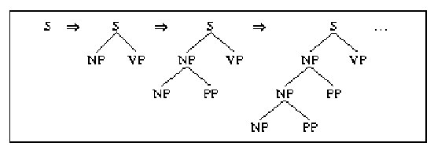
Left Recursion vs. Right Recursion
Depth-first search will never terminate if grammar is left recursive (e.g. NP --> NP PP)

Slide 27
Solutions:
Rewrite the grammar (automatically?) to a weakly equivalent one which is not left-recursive
e.g. The man {on the hill with the telescope…}
NP → NP PP (wanted: Nom plus a sequence of PPs)
NP → Nom PP
NP → Nom
Nom → Det N
…becomes…
NP → Nom NP’
Nom → Det N
NP’ → PP NP’ (wanted: a sequence of PPs)
NP’ → e
Not so obvious what these rules mean…
Notes:
Reordering rules doesn’t work:
you really want to choose the second rule on the first round and the first rule on the second round to handle the input…but...

Slide 28
Harder to detect and eliminate non-immediate left recursion
NP --> Nom PP
Nom --> NP
Fix depth of search explicitly
Rule ordering: non-recursive rules first
NP --> Det Nom
NP --> NP PP

Slide 29
Another Problem: Structural ambiguity
Multiple legal structures
Attachment (e.g. I saw a man on a hill with a telescope)
Coordination (e.g. younger cats and dogs)
NP bracketing (e.g. Spanish language teachers)

Slide 30
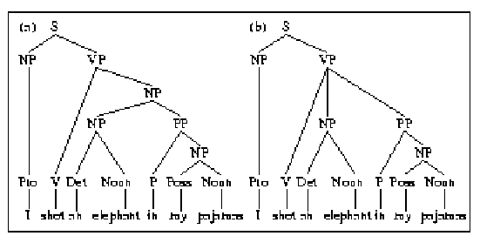
NP vs. VP Attachment

Slide 31
Solution?
Return all possible parses and disambiguate using “other methods”

Slide 32
Probabilistic Parsing

Slide 33
How to do parse disambiguation
Probabilistic methods
Augment the grammar with probabilities
Then modify the parser to keep only most probable parses
And at the end, return the most probable parse

Slide 34
Probabilistic CFGs
The probabilistic model
Assigning probabilities to parse trees
Getting the probabilities for the model
Parsing with probabilities
Slight modification to dynamic programming approach
Task is to find the max probability tree for an input

Slide 35
Probability Model
Attach probabilities to grammar rules
The expansions for a given non-terminal sum to 1
VP -> Verb .55
VP -> Verb NP .40
VP -> Verb NP NP .05
Read this as P(Specific rule | LHS)

Slide 36
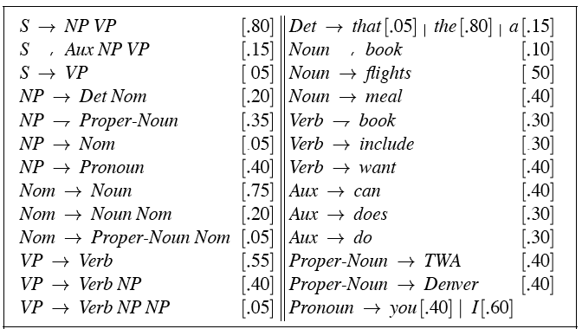
PCFG

Slide 37
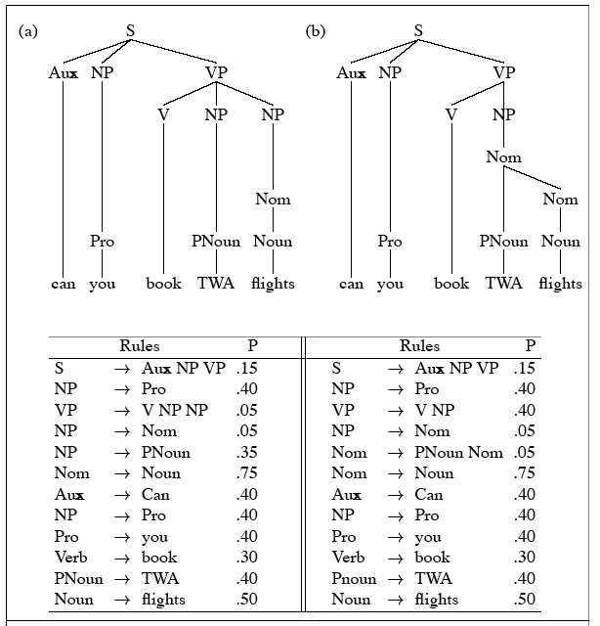
PCFG

Slide 38
Probability Model (1)
A derivation (tree) consists of the set of grammar rules that are in the tree
The probability of a tree is just the product of the probabilities of the rules in the derivation.

Slide 39
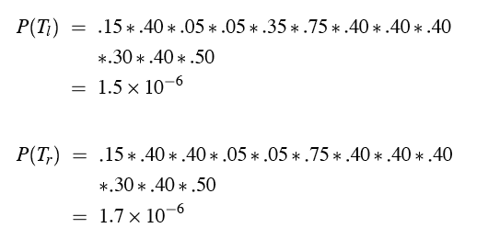
Probability model
P(T,S) = P(T)P(S|T) = P(T); since P(S|T)=1

Slide 40
Probability Model (1.1)
The probability of a word sequence P(S) is the probability of its tree in the unambiguous case.
It’s the sum of the probabilities of the trees in the ambiguous case.

Slide 41
Getting the Probabilities
From an annotated database (a treebank)
So for example, to get the probability for a particular VP rule just count all the times the rule is used and divide by the number of VPs overall.

Slide 42
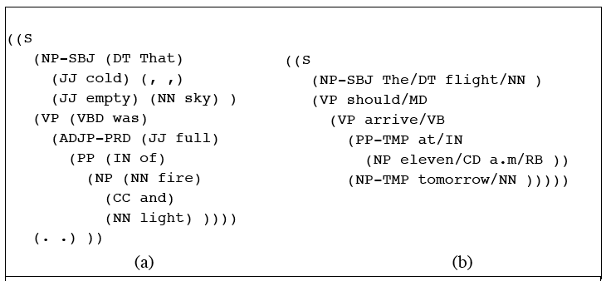
TreeBanks

Slide 43
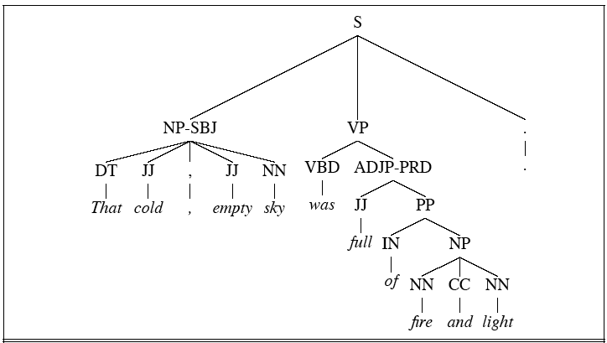
Treebanks

Slide 44
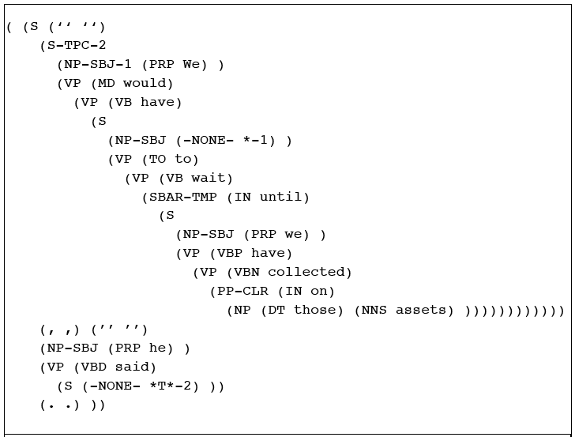
Treebanks

Slide 45
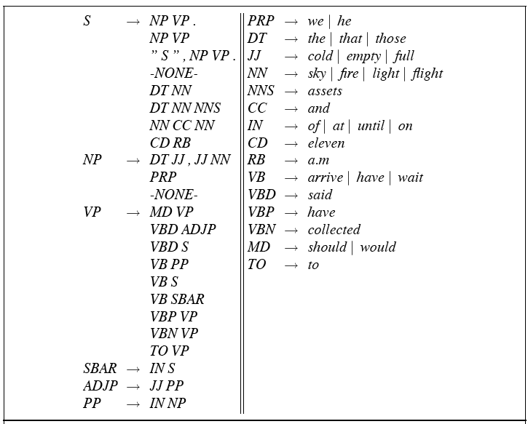
Treebank Grammars

Slide 46
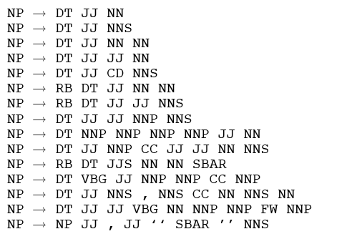
Lots of flat rules

Slide 47
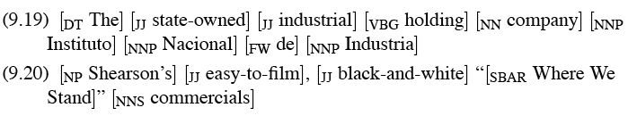
Example sentences from those rules
Total: over 17,000 different grammar rules in the 1-million word Treebank corpus

Slide 48
Probabilistic Grammar Assumptions
We’re assuming that there is a grammar to be used to parse with.
We’re assuming the existence of a large robust dictionary with parts of speech
We’re assuming the ability to parse (i.e. a parser)
Given all that… we can parse probabilistically

Slide 49
Typical Approach
Bottom-up (CKY) dynamic programming approach
Assign probabilities to constituents as they are completed and placed in the table
Use the max probability for each constituent going up

Slide 50
What’s that last bullet mean?
Say we’re talking about a final part of a parse
S->₀NP_{i}VP_{j}
The probability of the S is…
P(S->NP VP)*P(NP)*P(VP)
The green stuff is already known. We’re doing bottom-up parsing

Slide 51
Max
I said the P(NP) is known.
What if there are multiple NPs for the span of text in question (0 to i)?
Take the max (where?)

Slide 52
Problems with PCFGs
The probability model we’re using is just based on the rules in the derivation…
Doesn’t use the words in any real way
Doesn’t take into account where in the derivation a rule is used

Slide 53
Solution
Add lexical dependencies to the scheme…
Infiltrate the predilections of particular words into the probabilities in the derivation
I.e. Condition the rule probabilities on the actual words

Slide 54
Heads
To do that we’re going to make use of the notion of the head of a phrase
The head of an NP is its noun
The head of a VP is its verb
The head of a PP is its preposition
(It’s really more complicated than that but this will do.)

Slide 55
Example (right)
Attribute grammar

Slide 56
Example (wrong)

Slide 57
How?
We used to have
VP -> V NP PP P(rule|VP)
That’s the count of this rule divided by the number of VPs in a treebank
Now we have
VP(dumped)-> V(dumped) NP(sacks)PP(in)
P(r|VP ^ dumped is the verb ^ sacks is the head of the NP ^ in is the head of the PP)
Not likely to have significant counts in any treebank

Slide 58
Declare Independence
When stuck, exploit independence and collect the statistics you can…
We’ll focus on capturing two things
Verb subcategorization
Particular verbs have affinities for particular VPs
Objects affinities for their predicates (mostly their mothers and grandmothers)
Some objects fit better with some predicates than others

Slide 59
Subcategorization
Condition particular VP rules on their head… so
r: VP -> V NP PP P(r|VP)
Becomes
P(r | VP ^ dumped)
What’s the count?
How many times was this rule used with (head) dump, divided by the number of VPs that dump appears (as head) in total

Slide 60
Example (right)
Attribute grammar

Slide 61
Probability model
P(T,S) = S-> NP VP (.5)*
VP(dumped) -> V NP PP (.5) (T1)
VP(ate) -> V NP PP (.03)
VP(dumped) -> V NP (.2) (T2)

Slide 62
Preferences
Subcategorization captures the affinity between VP heads (verbs) and the VP rules they go with.
What about the affinity between VP heads and the heads of the other daughters of the VP
Back to our examples…

Slide 63
Example (right)

Slide 64
Example (wrong)

Slide 65
Preferences
The issue here is the attachment of the PP. So the affinities we care about are the ones between dumped and into vs. sacks and into.
So count the places where dumped is the head of a constituent that has a PP daughter with into as its head and normalize
Vs. the situation where sacks is a constituent with into as the head of a PP daughter.

Slide 66
Probability model
P(T,S) = S-> NP VP (.5)*
VP(dumped) -> V NP PP(into) (.7) (T1)
NOM(sacks) -> NOM PP(into) (.01) (T2)

Slide 67
Preferences (2)
Consider the VPs
Ate spaghetti with gusto
Ate spaghetti with marinara
The affinity of gusto for eat is much larger than its affinity for spaghetti
On the other hand, the affinity of marinara for spaghetti is much higher than its affinity for ate

Slide 68
Preferences (2)
Note the relationship here is more distant and doesn’t involve a headword since gusto and marinara aren’t the heads of the PPs.
Vp (ate)
Vp(ate)
Vp(ate)
Np(spag)
Pp(with)
np
Pp(with)
v
np
v
Ate spaghetti with gusto
Ate spaghetti with marinara

Slide 69
Summary
Context-Free Grammars
Parsing
Top Down, Bottom Up Metaphors
Dynamic Programming Parsers: CKY. Earley
Disambiguation:
PCFG
Probabilistic Augmentations to Parsers
Tradeoffs: accuracy vs. data sparcity
Treebanks

